Slide 1

Introduction to Computer Systems
MIPS Assembly Language - Part 1
Direct Link to view these slides on Google Docs

Slide 2
What to expect in this topic:
What happens below your program
Why learn MIPS Assembly language?
Abstraction diagrams of MIPS processors
MIPS CPU registers
Introduction to words in RAM
Following instructions

Slide 3
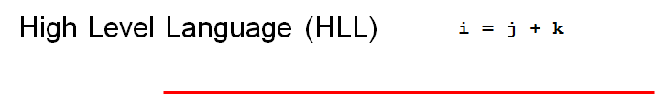
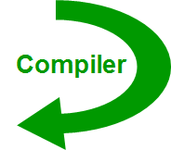
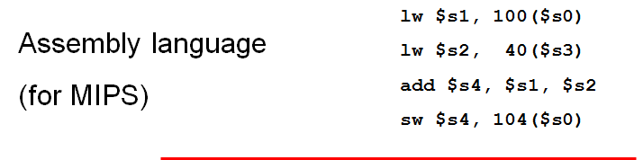
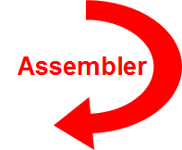
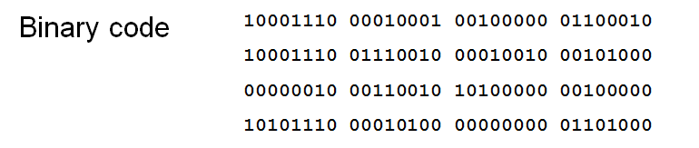
What happens below your program?
- The compiler decides where in memory to store variables
- Converts high level language into assembly language
A computer cannot really understand an assembly program directly
- Assembler produces machine code to one to one correspondence between assembly language statements and machine language instructions

Slide 4
Below your program
HLL program
compiler
assembly program
assembler
object: machine language program
object: libraries
A computer program that takes one or more object files generated by a compile and combines them into a single executable file.
linker
executable
memory
loader

Slide 5
Why learn about MIPS assembly?
We learn how complex programs must be actually producing assembly code
We get an insight into complexity of operations

Slide 6
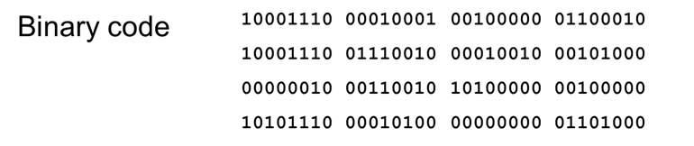
What is assembly language?
Computer instructions can be represented as sequences of bits.
Generally, this is the lowest possible level of representation for a program.
Each instruction is equivalent to a single, indivisible action of the CPU.
This representation is called Machine language/Code or object code.
Machine language is the only language a computer is capable of understanding.
A slightly higher-level representation (and one that is much easier for humans to use) is called Assembly language.

Slide 7
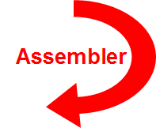
What is assembly language?
Sometimes referred to as Assembly or ASM.
An assembly language is a low-level programming language.
Programs written in assembly language are compiled by an Assembler.
Assembly_Program.asm
Binary/machine language
Every assembler has its own assembly language, which is designed for one specific computer architecture (processor design).

Slide 8
Why
Programming in assembler is much easier for a human to read and understand rather than machine language.
Use assembly to speak directly to your computer’s processor.
Assembly language is used primarily for direct hardware manipulation.
Assembly language gives you complete control over the system’s resources.

Slide 9
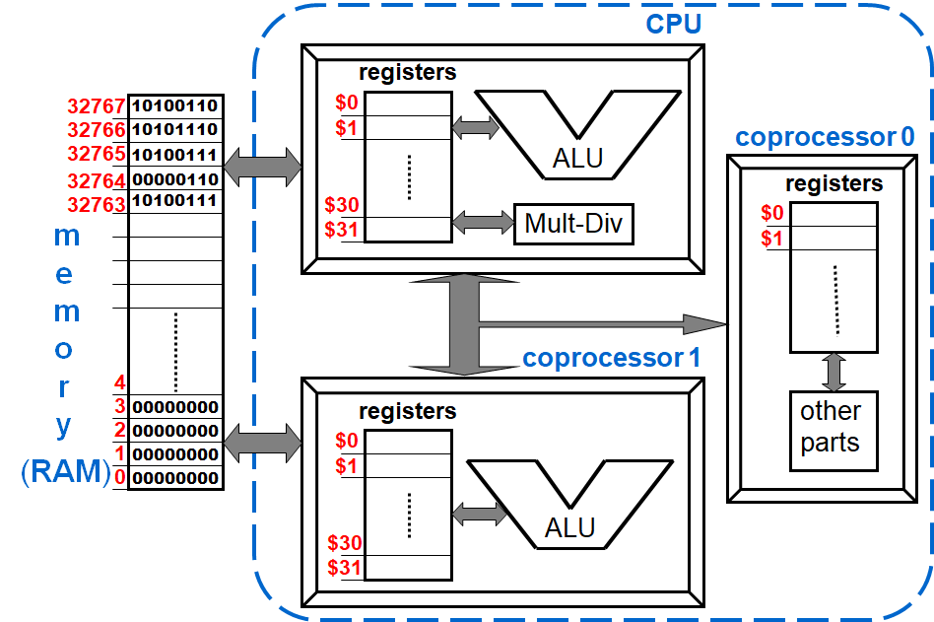
MIPS abstract view
Note: MIPS has a number of co-processors for floating point and for I/O that are not considered here. Only the main processor is considered in this example/

Slide 10
What and Why MIPS
Is an assembly language designed for RISC computers. So we can say it is a RISC assembly language.
A simple language with a simple ISA as well (to help the programmers to write simple, more efficient code easier with fewer lines).
MIPS gives you the ability to:
learn different types of assembly languages e.g. ARM and x86 for Intel
Programming different machines and devices e.g. Playstation
Since we use computers based on x86 (Intel microprocessors), therefore we need a Simulator !! to run MIPS assembly language on PC with Intel Microprocessor.
MARS (MIPS Assembler and Runtime simulator)
An Interactive Development Environment (IDE) for MIPS Assembly Language Processing

Slide 11
MIPS’ CPU registers
Number | Name | Use
0 | $zero | Constant value 0
1 | $at | Reserved for assembler
2,3 | $v0, $v1 | Return values from functions
4-7 | $a0…$a3 | Arguments to functions (X)
8-15 | $t0... $t7 | Temporary data registers (X)
16-23 | $s0…$s7 | Temporaries (preserved)
24-25 | $t8, $t9 | More temporary registers (X)
26-27 | $k0, $k1 | Reserved by OS
28 | $gp | Global pointer
29 | $sp | Stack pointer
30 | $fp | Frame pointer
31 | $ra | Return address
Names are those supported by the MIPS assembler program
Uses are sometimes required, e.g.$zero cannot be written to
Some uses are conventions of the assembler e.g. $at is used by assembler to convert single assembly language instruction to multiple machine language instructions
Others are conventions of the operating system and programmers e.g. $a0…$a3 and the conventions on which registered are preserved
- means that
These registers are Not preserved by subprograms

Slide 12
Editable MIPS’ CPU registers
Number | Name | Use
0 | $zero | Constant value 0
1 | $at | Reserved for assembler
2,3 | $v0, $v1 | Return values from functions
4-7 | $a0…$a3 | Arguments to functions
8-15 | $t0... $t7 | Temporaries (not preserved)
16-23 | $s0…$s7 | Temporaries (preserved)
24-25 | $t8, $t9 | Temporaries (not preserved)
26-27 | $k0, $k1 | Reserved by OS
28 | $gp | Global pointer
29 | $sp | Stack pointer
30 | $fp | Frame pointer
31 | $ra | Return address
These are the registers we can use in our programs

Slide 13
MIPS’ CPU Registers
During assembly, the assembler translates each pseudo instruction into one or more machine language instructions.
Pseudo Instructions are special commands to the assembler about the positioning of the program.
These are simple assembly language instructions that do not have a direct machine language equivalent.
Example
move $t0, $t1 # $t0 = $t1 ~ $t0 ⇐ $t1
The assembler will translate it to
add $t0, $zer0, $t1 # $t0 = 0 + $t1

Slide 14
Instructions: add & sub
In the following <r1>, <r2> and <r3> indicate registers, while N indicates an integer number.
add <r1>,<r2>,<r3> #Put in <r1> the result of <r2> + <r3>
sub <r1>,<r2>,<r3> #Put in <r1> the result of <r2> - <r3>
add <r1>,<r2>,N #Put in <r1> the result of <r2> + N
sub <r1>,<r2>,N #Put in <r1> the result of <r2> - N
Notice that the assembler will generate different machine instructions depending on how the operand is described

Slide 15
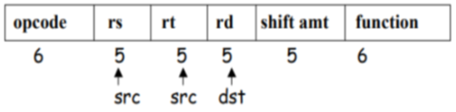
Instructions: add & sub
Example: (let $s1=3, $s2=4, $t1=1)
add $t0,$s1,$s2 # $t0 = 3+4 = 7
sub $s0,$t0,$t1 # $s0 = 7-1 = 6
add $t0,$t0,54 # $t0 = 7+54 = 61
sub $s2,$s1,5 # $s2 = 3-5 = -2
R-Type Format

Slide 16
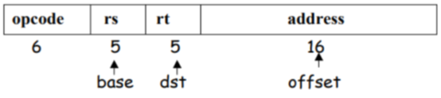
Instructions: lw & sw
In the following <r1> and <r2> indicate registers
While ɛ is a displacement added to the register to give an address
Address is always a multiple of 4.
lw <r1>,e(<r2>) # Load <r1> with the word (having address) <r2> + e
sw <r1>,e(<r2>) # Store contents of <r1> at address <r2> + e
I-Type Format

Slide 17
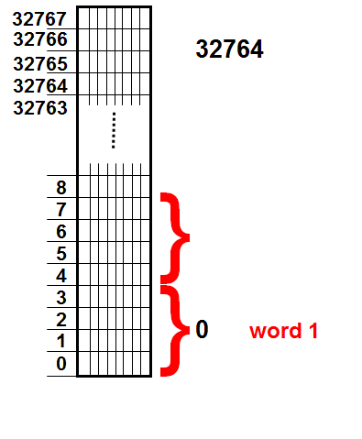
The RAM
Address is always a multiple of 4.
0 address + 8
8 word 3
4 word 2
0 address + 4
0 address
Q: Can 32150 be the address of a word in MIPS?
A: No, it is not divisible by 4

Slide 18
Instructions: lw & sw
Perform <word 1> + <word 2> - <word 3>
and put the result in <word 3>
assuming that $s1 contains the
address of <word 1>.
lw $t0,0($s1) # $t0 = <word 1>
lw $t1,4($s1) # $t1 = <word 2>
add $t2,$t0,$t1 # $t2 = <word 1> + <word 2>
lw $t0,8($s1) # $t0 = <word 3>
sub $t3,$t2,$t0 # $t3 = <word 1> + <word 2> - <word 3>
sw $t3,8($s1) # <word 3> = <word 1> + <word 2> - <word 3>

Slide 19
Binary: the language spoken by the CPU
A binary alphabet: {0, 1}
How to represent many symbols with only 0’s and 1’s?
Symbols to represent | Binary representation
A | 00
B | 01
C | 10
D | 11
Think about:
How many bits are needed to represent 5 values?
How many different combinations of n bits is it possible to have?

Slide 20
Representing instructions
add $t0,$s1,$s2
000000 10001 10010 01000 00000 100000
fields

Slide 21
Representing instructions
add $t0,$s1,$s2
000000 10001 10010 01000 00000 100000
identify the instruction

Slide 22
Representing instructions
add $t0,$s1,$s2
000000 10001 10010 01000 00000 100000
first source operand of the operation ($s1)

Slide 23
Representing instructions
add $t0,$s1,$s2
000000 10001 10010 01000 00000 100000
second source operand of the operation ($s2)

Slide 24
Representing instructions
add $t0,$s1,$s2
000000 10001 10010 01000 00000 100000
number of the register that receives the result of the operation ($t0)

Slide 25
Representing instructions
add $t0,$s1,$s2
000000 10001 10010 01000 00000 100000
not used for this instruction

Slide 26
Representing instructions
000000 10001 10010 01000 00000 100000
op rs rt rd sham func

Slide 27
Representing instructions
000000 10001 10010 01000 00000 100000
6 + 5 + 5 + 5 + 5 + 6 =
32

